Slide 1
Personality

Slide 2
The Big-Five Model
Five factor model of personality
A lot of research supports that five basic dimensions underlie all others and cover most of the significant variation of human personality
Extraversion
Agreeableness
Conscientiousness
Emotional Stability [Neuroticism]
Openness to Experience

Slide 3
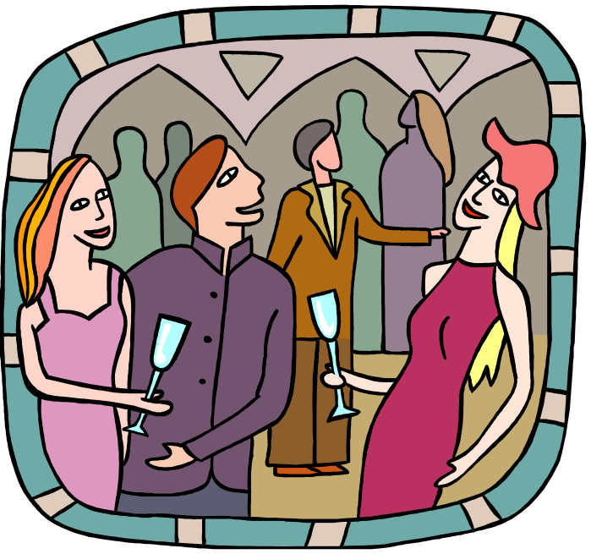
Extraversion -
Captures the comfort level of an individual in relationships
Tends to be gregarious, assertive, sociable
Introverts tend to be timid, reserved and quiet

Slide 4
Agreeableness –
Refers to an individual's propensity to defer to others
Highly agreeable people are cooperative, warm, trusting.
Disagreeable people are cold, antagonistic
Conscientiousness - a measure of reliability
Highly conscientious individual is responsible, organised, dependable and persistent
Low scores on this factor are easily distracted, disorganised and unreliable.

Slide 5

Emotional stability (converse of neuroticism)
taps a person's ability to withstand stress
High scores in this factor = calm, self confident, secure
Low scores in this factor are nervous, anxious, depressed, insecure

Slide 6

Openness to experience
This factor seeks to show the openness of individuals through their interests and fascination for new ideas and developments.
High scores in this factor are Creative, curious, artistically sensitive
Low scores are conventional and find comfort in the familiar

Slide 7
How does the Big 5 predict work behaviour
Research evidence shows that individuals who are dependable, reliable, careful, thorough, able to plan, organised, hardworking, persistent and achievement oriented tend to have a higher job performance in almost all occupations
Although Conscientiousness factor is most consistent in relation to job performance, the other factors have implications for life and work.

Slide 8
How the Big 5 traits influence OB criteria
Trait
Why it is important
What does it affect
Emotional stability
Less negative thinking and fewer negative emotions
Less hyper vigilant
Higher job and life satisfaction
Lower stress levels
Better interpersonal skills
Greater social dominance
More emotionally expressive
Higher performance*
Enhanced leadership
H Job & life satisfaction
Extraversion
Increased learning
More creative
More flexible and autonomous
training performance
Enhanced leadership
Adaptable to change
openness
Better liked
More compliant, conforming
Higher performance*
Lower levels of deviant behaviour
agreeableness
Greater effort, persistence
More drive, discipline
Better organised, planning
Higher performance
Enhanced leadership
Greater longevity
conscientiousness

Slide 9
Measuring Personality
Self Report Surveys
Observer Ratings Survey
Projective Measures

Slide 10
Self Report Survey
Most common way to measure
concern 1: individual might lie to create good impression
concern 2: accuracy of the method (good candidate may have been in a bad mood while filling up.

Slide 11
Observer Ratings
Provides independent assessment of personality
A co-worker or someone else could give the rating for the individual
concern 1: May give wrong rating
concern 2: relationships may prejudice report
One of the best ways 360⁰ assessment

Slide 12
Projective Measures
Rorchach Inkblot Test : individual is supposed to state what the inkblot resemble.
Thematic Aperception Test [TAT] uses a series of drawings or photos on cards and the individual writes a story about each picture.
concern 1: assessment is fraught with perceptual biases. Therefore very rarely used.

Slide 13


Slide 14


Slide 15


Slide 16
Personality attributes influencing OB
Core Self Evaluation:
  People differ in the degree to which they like/dislike themselves and whether they see themselves as capable and effective.
  Positive core self evaluation
    Like themselves, see themselves as effective, capable, in control of their environment
  Negative core self evaluation
    Dislike themselves, question own abilities, view self as powerless.
  Core self evaluation is determined by two elements: Self Esteem and Locus of control.

Slide 17
Self esteem:
Individual’s degree of liking/disliking self
Worthy/unworthy
High self esteem = positive view and capable
Low self esteem = susceptible to external influence : seek approval, conform to belief or behaviour of those they respect
Locus of control
Degree to which people believe that they are in control of their fate.
Internals: believe they control what happens to them
External: believe what happens is through outside forces like luck or chance

Slide 18
Core self evaluation & job satisfaction
Positive self evaluation
  see more challenge in the job = more job satisfaction
  Tend to get more complex and challenging jobs
  Attribute positive outcomes to their own actions
  Perform better as they set more ambitious goals
  Concern: overconfidence can lead to wrong/bad decisions

Slide 19
Machiavellianism
Tendency to manipulate and maintain emotional distance. Believes in ‘The ends justify the means’
Named after Niccoli Machiavelli, who wrote in 16th century on how to gain and use power.
High Machs flourish in:
  Face to face interactions
  Situations allowing latitude for improvising
High Machs do well in jobs that
  offer rewards for winning,
  requiring bargaining skills

Slide 20
Narcissism
From Greek myth of Narcissus, a man so vain and proud he fell in love with his own image
In psychology, narcissism describes one who has a grandiose sense of self importance, needs admiration, sense of entitlement, is arrogant, likes to be the center of attention
Think they are better leaders while others rate them the worst leaders
Tend to be selfish and exploitive, others exist for their benefit

Slide 21
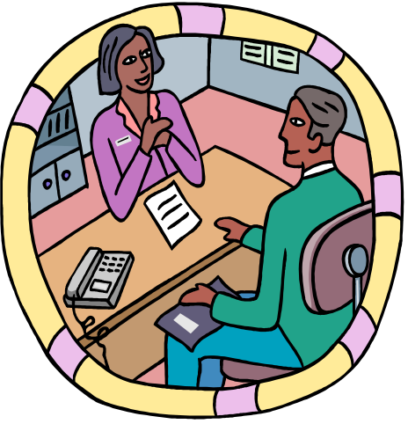
Self Monitoring
Individual’s ability to adjust / adapt his or her behaviour to external, environmental factors
High self monitors are capable of presenting contradictions between their public and private persona.
More capable of conforming
Likely to receive better ratings, can emerge as leaders, less committed to organisations
Low self monitors tend to display their true positions and attitudes in every situations = high behavioural consistency

Slide 22
Risk Taking
People differ in their willingness to take chances
Willingness or propensity to take risks
High risk takers make quicker decisions and need less information in making their choices
Decision accuracy was the same for high and low risk takers
High risk takers are suitable for areas like stock markets or sectors needing quick decisions (not for accounting)‏
Donald Trump : start with almost nothing in 1960s – by 1980s made fortune [New York Real Estate] – in 1994 had negative net worth of $850m – took risks on few assets – by 2004, Forbes estimated his net worth $2.6b.

Slide 23

Type A personality
Excessively competitive and experiencing a sense of time urgency
Chronic, incessant struggle to achieve more in less time
Type A’s
  Are always moving, walking, eating rapidly
  Feel impatient at the rate that events take place
  Try to do more than one thing at a time
  Cannot cope with leisure time
  Obsessed with numbers : measure their success in terms of how many/how much they acquired

Slide 24
Type B personality
Exact opposite of Type A
Rarely hurried by desire to obtain things
Type B’s:
  Never suffer from sense of urgency
  Feel no need to display or discuss their achievements unless really required
  Play for fun and relaxation rather than to exhibit their superiority
  Can relax without guilt

Slide 25
Type A’s operate in moderate or high levels of stress
Subject themselves to pressure and deadlines
Fast workers, work long hours
Rarely creative
Easier to predict their behaviour

Slide 26
Proactive personality
Actively take the initiative to improve on their present circumstances OR create opportunities for themselves.
Proactives identify opportunities, show initiative, take action and persevere until meaningful change occurs
Proactives have desirables that organisations want
More likely to be seen as leaders/ change agents
More likely to question status quo or voice their displeasure when situations are not to their liking

